Slide 1
Critical Thinking (BES-103)
Lecture 1
Introduction to Critical Thinking
Hadiqua Fazal
Assistant Professor
Computer Science Department

Slide 2
Course Objectives
To enable students to apply the general principles of logic that make patterns of argument valid or invalid;
To develop an in‐depth understanding of the concept and process of critical thinking;
To strengthen students’ ability to take ownership of content by actively thinking it through, value questions over answers, and seek understanding over memorization.

Slide 3
Resources
Main
Bassham, G, Irwin., Nardone, H, Wallace, J. Critical thinking: A Student’s Introduction. New York: McGraw‐Hill, 2011
Ruggiero, R, V. Beyond Feelings: A Guide to Critical Thinking. New York: McGraw‐Hill, 2012

Slide 4
Course Policy
Attendance
Students are expected to attend all classes
Attendance is compulsory and will be taken regularly.
Attendance for less than 80% of the lectures will result in students being barred from taking the Final Exam.

Slide 5
Course Policy
Homework (Assignments)
Homework are due at the beginning of class,
Late homework will not be accepted,
All works have to be done independently,
Students handing in similar homework will receive a grade of 0 (ZERO) and face possible disciplinary actions.

Slide 6
Class Rules
Cell phones are restricted during class.
Cell phones must be turned off during the lecture.
If your cell phone rings during class, you may be asked to leave.
No discussion with each other during lecture
Maintain discipline.

Slide 7
Course Assessment
Assessment Criteria
Mid – Term 20%
Final Exam 50%
Quizzes 10%
Class Assignments/Term Project 20%

Slide 8
Lecture Outline
What is critical thinking?
Critical thinking standards.
Benefits
Barriers
Characteristics

Slide 9

Question

Slide 10

Do you agree?
Why is Imagination so important?
I need input from you!

Slide 11
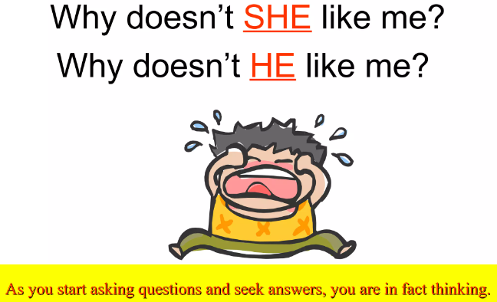
What is thinking?
The action of using one's mind to produce thoughts

Slide 12
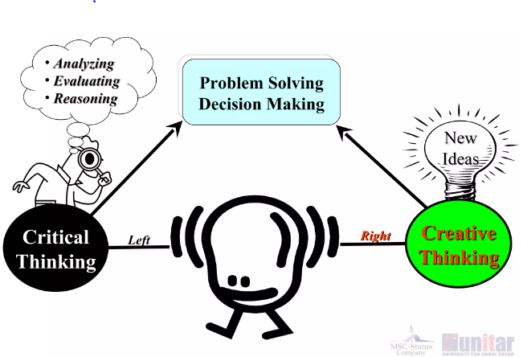
Types of thinking

Slide 13
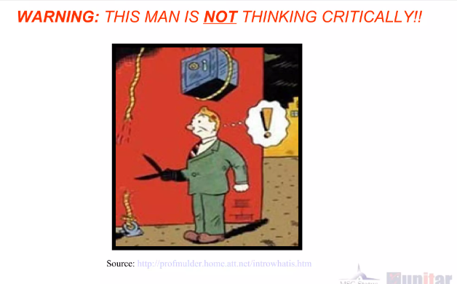
What is critical thinking?

Slide 14
What is critical thinking?
“Critical thinking is the intellectually disciplined process of actively and skillfully conceptualizing, applying, analyzing, synthesizing, and/or evaluating information gathered from, or generated by, observation, experience, reflection, reasoning, or communication, as a guide to belief and action”
Michael Scriven and Richard Paul (2003)

Slide 15
What is critical thinking?
Critical Thinking is the general term given to a wide range of cognitive and intellectual skills needed to:
Effectively identify, analyze, and evaluate arguments.
Discover and overcome personal prejudices and biases.
Formulate and present convincing reasons in support of conclusions.
Make reasonable, intelligent decisions about what to believe and what to do.

Slide 16
Why Develop Critical Thinking Skills?
Critical thinking skills are important for several reasons.
These include helping you work independently and solve problems.
Analyze different viewpoints
Come up with the best solution for complex problems
Become a better learner

Slide 17
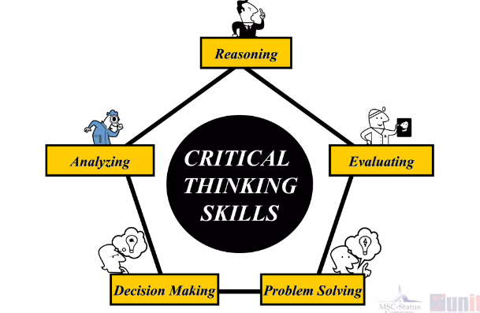
Critical Thinking Skills

Slide 18

Developing Critical Thinking Skills
Analyzing
Understanding the significance and meaning of information
Breaking information down into parts
Connecting and combining information to better understand the relationship between the information

Slide 19

Developing Critical Thinking Skills
Reasoning
Reasoning is the act or process of drawing conclusions from facts, evidence etc.
Notes:
https://missionself.com/developing-critical-thinking-skills

Slide 20

Developing Critical Thinking Skills
Evaluating
Judging the value, credibility, or strength of something

Slide 21
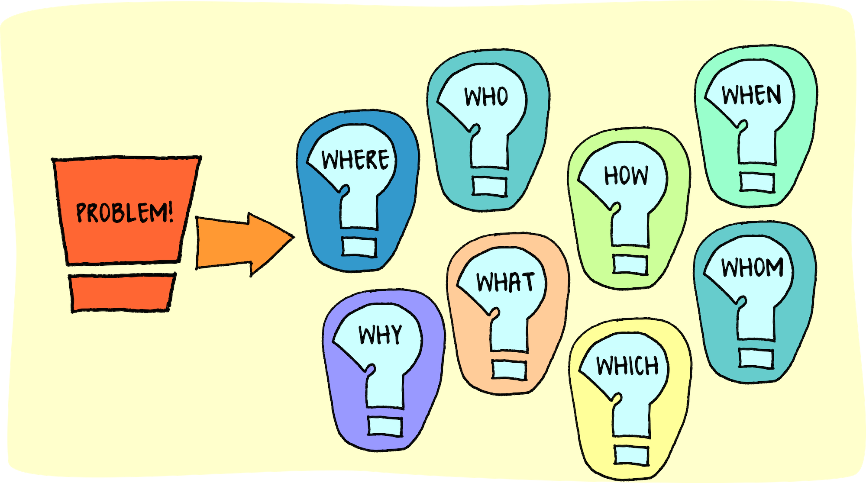
Developing Critical Thinking Skills
Problem-Solving
The act of defining a problem; determining the cause of the problem; identifying, prioritizing, and selecting alternatives for a solution; and implementing a solution.

Slide 22

Developing Critical Thinking Skills
Decision Making
The cognitive process results in the selection of a belief or a course of action among several possible alternative options.

Slide 23

Exercise
Give 5 uses of a pen other than writing.

Slide 24
Merits of Critical thinking and demerits of non-critical thinking
Critical Thinker
Have a passionate drive for clarity precision, accuracy, and other critical thinking standards
Are skilled at understanding, analyzing, and evaluating arguments and viewpoints.
Reason logically and draw appropriate conclusions from evidence and data.
Reason logically and draw appropriate conclusions from evidence and data.
Non-Critical Thinker
Have a passionate drive for clarity precision, accuracy, and other critical thinking standards
Often misunderstand or evaluate unfairly arguments and viewpoints
Reason logically and draw appropriate conclusions from evidence and data.
Pretend they know more than they do and ignore their limitations.

Slide 25
Merits of Critical thinking and demerits of non-critical thinking
Critical Thinker
Listen open-mindedly to opposing points of view and welcome criticisms of beliefs and assumptions
Are closed-minded and resist criticisms of beliefs and assumptions
Are closed-minded and resist criticisms of beliefs and assumptions
Pursue truth and are curious about a wide range of issues
Non-Critical Thinker
Are closed-minded and resist criticisms of beliefs and assumptions
Are closed-minded and resist criticisms of beliefs and assumptions
Tend to engage in “groupthink,” uncritically following the beliefs and values of the crowd.
Are often relatively indifferent to truth and lack curiosity.

Slide 26
Reference
https://missionself.com/developing-critical-thinking-skills
https://www.slideshare.net/mqamarhayat/introduction-to-critical-thinking-8850972?from_action=save

